Slide 1

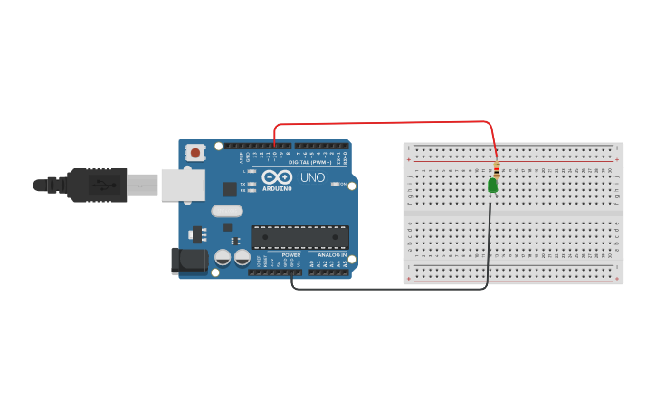

Smart Stick For Blind using Arduino

Slide 2
TABLE OF CONTENTS
01
02
03
04
OBJECTIVES
METHODOLOGY
RESULTS
CONCLUSIONS

Slide 3


Group Members
Mohamed Abdirazak Adam
Abdullahi Muse Hussein

Slide 4

—Mehmet
“It's sort of like cooking. You don't need to be a chef to cook but almost everyone cooks something."

Slide 5
01
OBJECTIVES

Slide 6
1. How to use Arduino to create a practical solution for visually impaired individuals. 2. The basics of circuit building and prototyping using a arduino uno. 3. How to interface an ultrasonic sensor with Arduino to detect obstacles in real-time. 4. How to program the Arduino board to process sensor data and control external components. 5. The importance of incorporating audio and visual feedback to enhance user experience. 6. Practical applications of Arduino in developing assistive technologies. 7. How to apply problem-solving and innovation skills to address challenges faced by visually impaired individuals
What you will learn this project

Slide 7
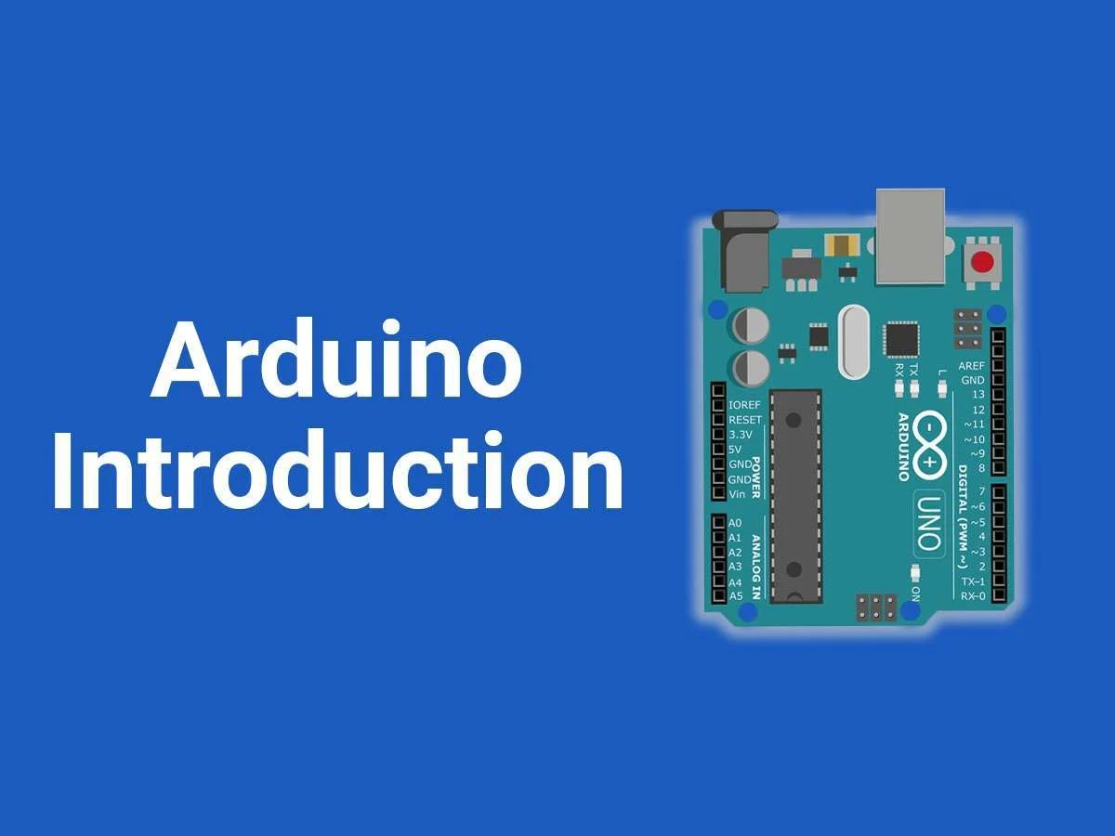
Introduction
Blind individuals encounter numerous obstacles in their daily lives, and one significant challenge is navigating through busy streets. With vehicles and obstacles posing potential risks, ensuring their safety becomes crucial. The Smart Blind Stick, powered by Arduino and equipped with an ultrasonic sensor, addresses this issue by providing real-time alerts to the user when it detects blockages in their path. This innovative device enhances mobility and minimizes the risk of accidents for visually impaired individuals, offering them greater independence and peace of mind.

Slide 8
02
Methodology

Slide 9
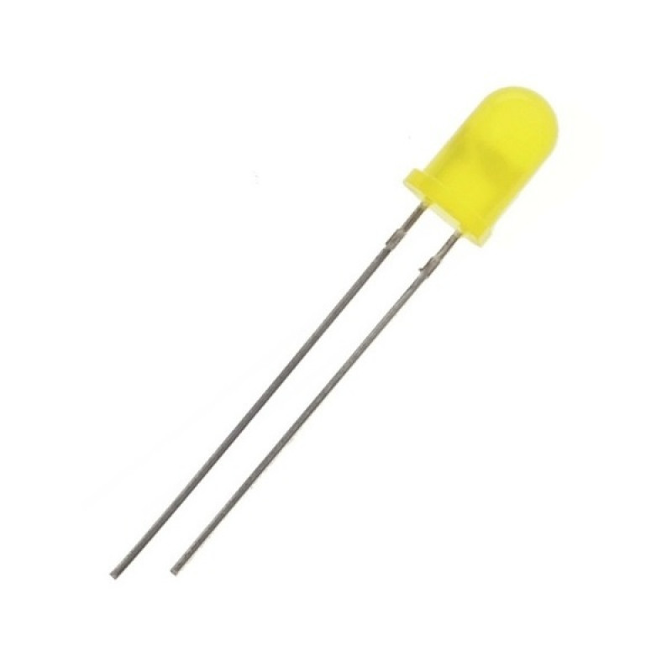
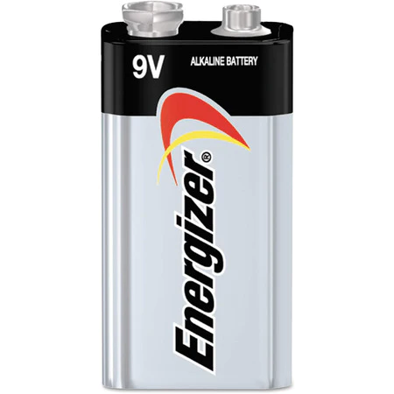
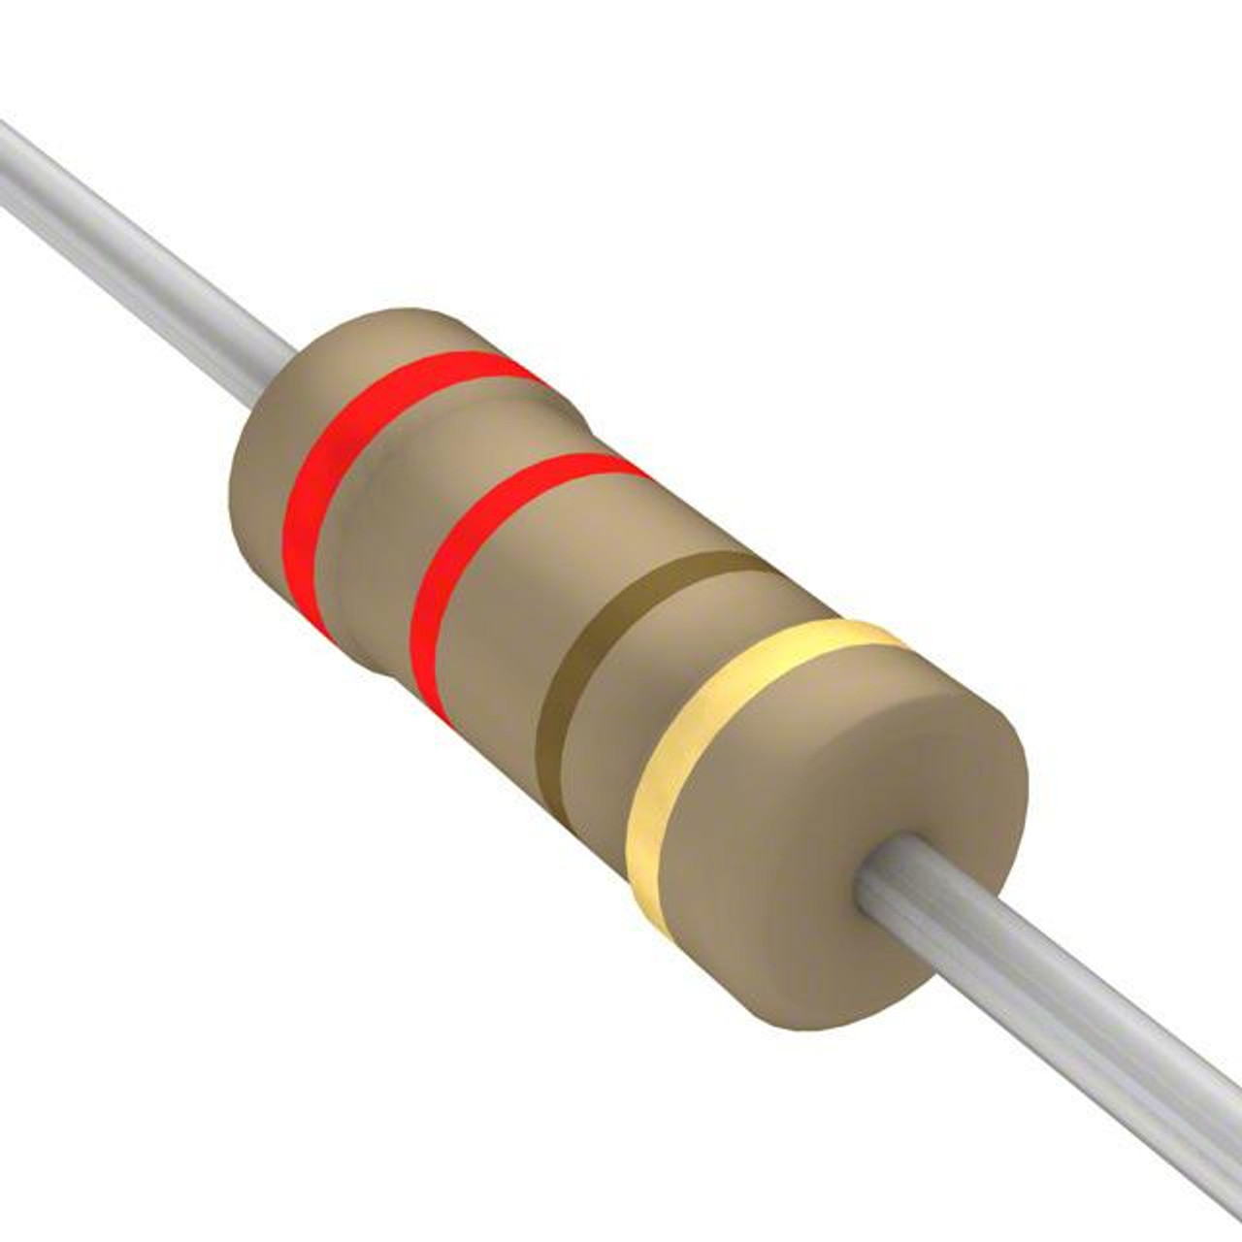
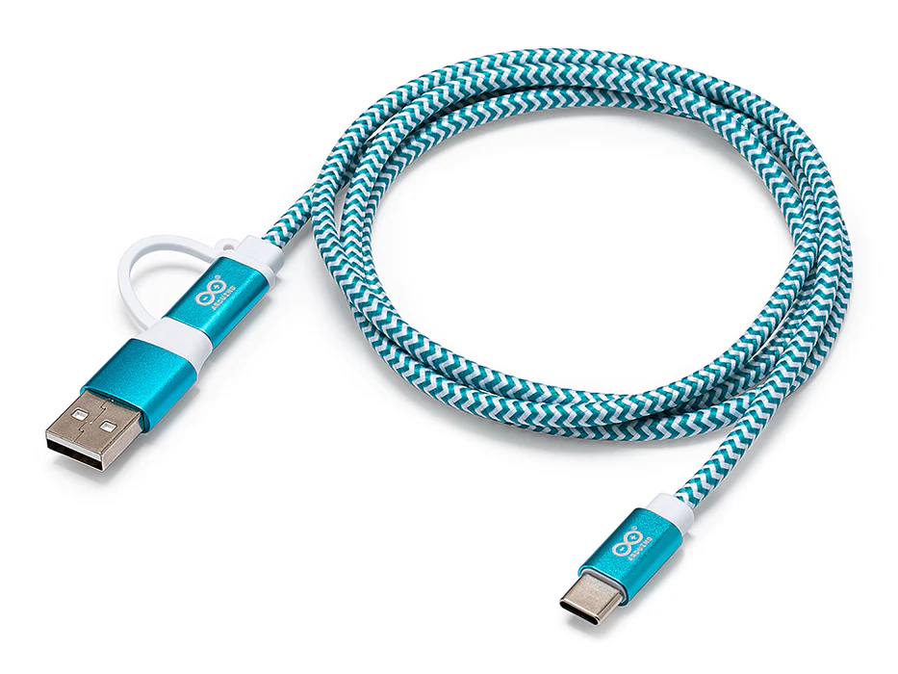
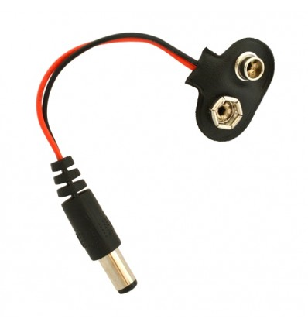
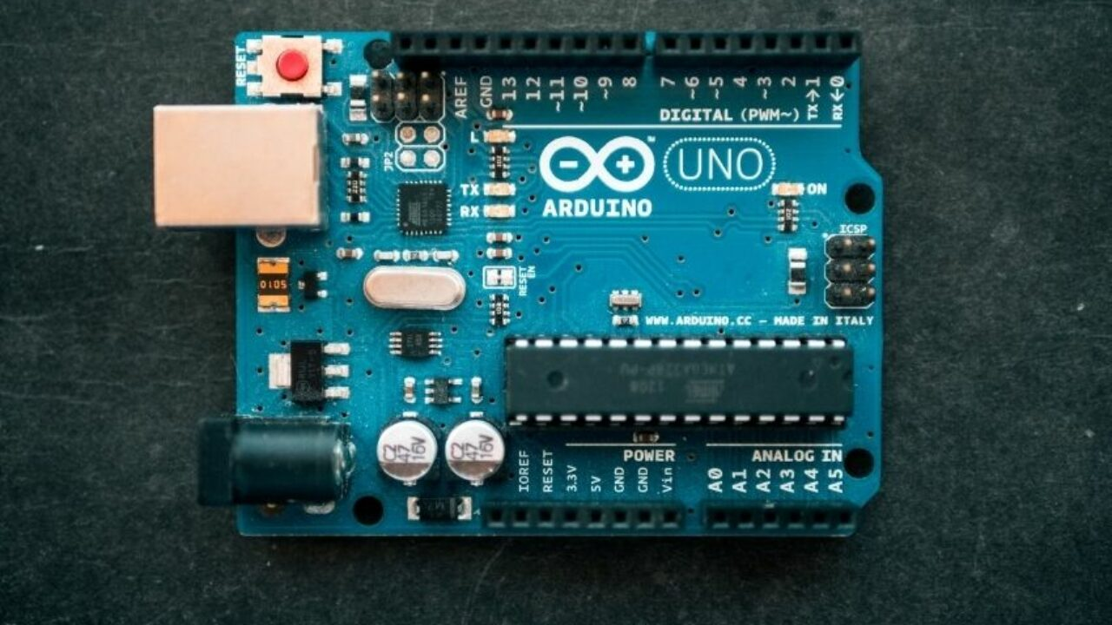
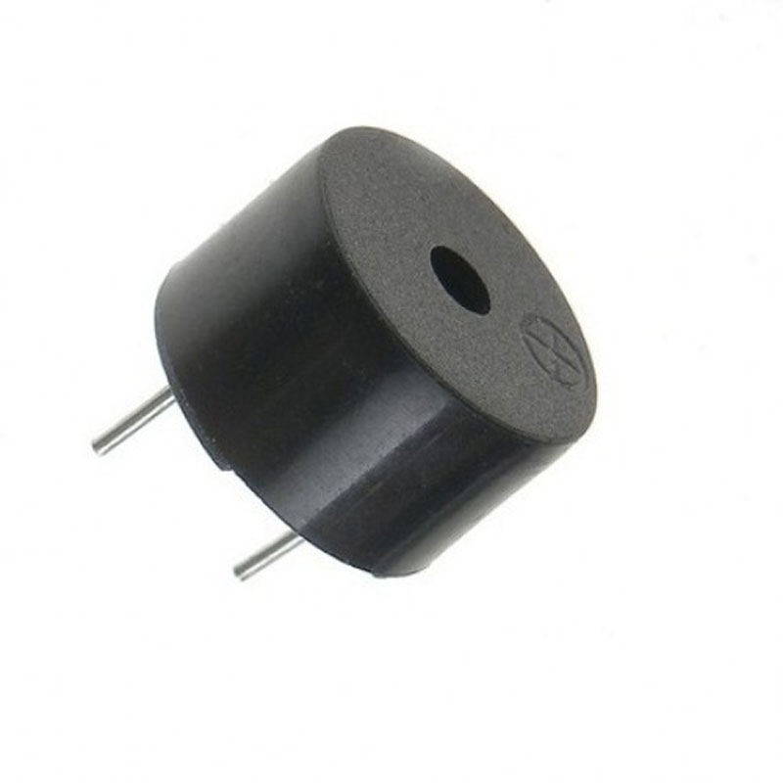
Methodology
LED
9V Battery
Resistor (220 ohms)
USB CABLE
Battery Connector
Arduino Board
Buzzer

Slide 10

Code Implementation

Slide 11
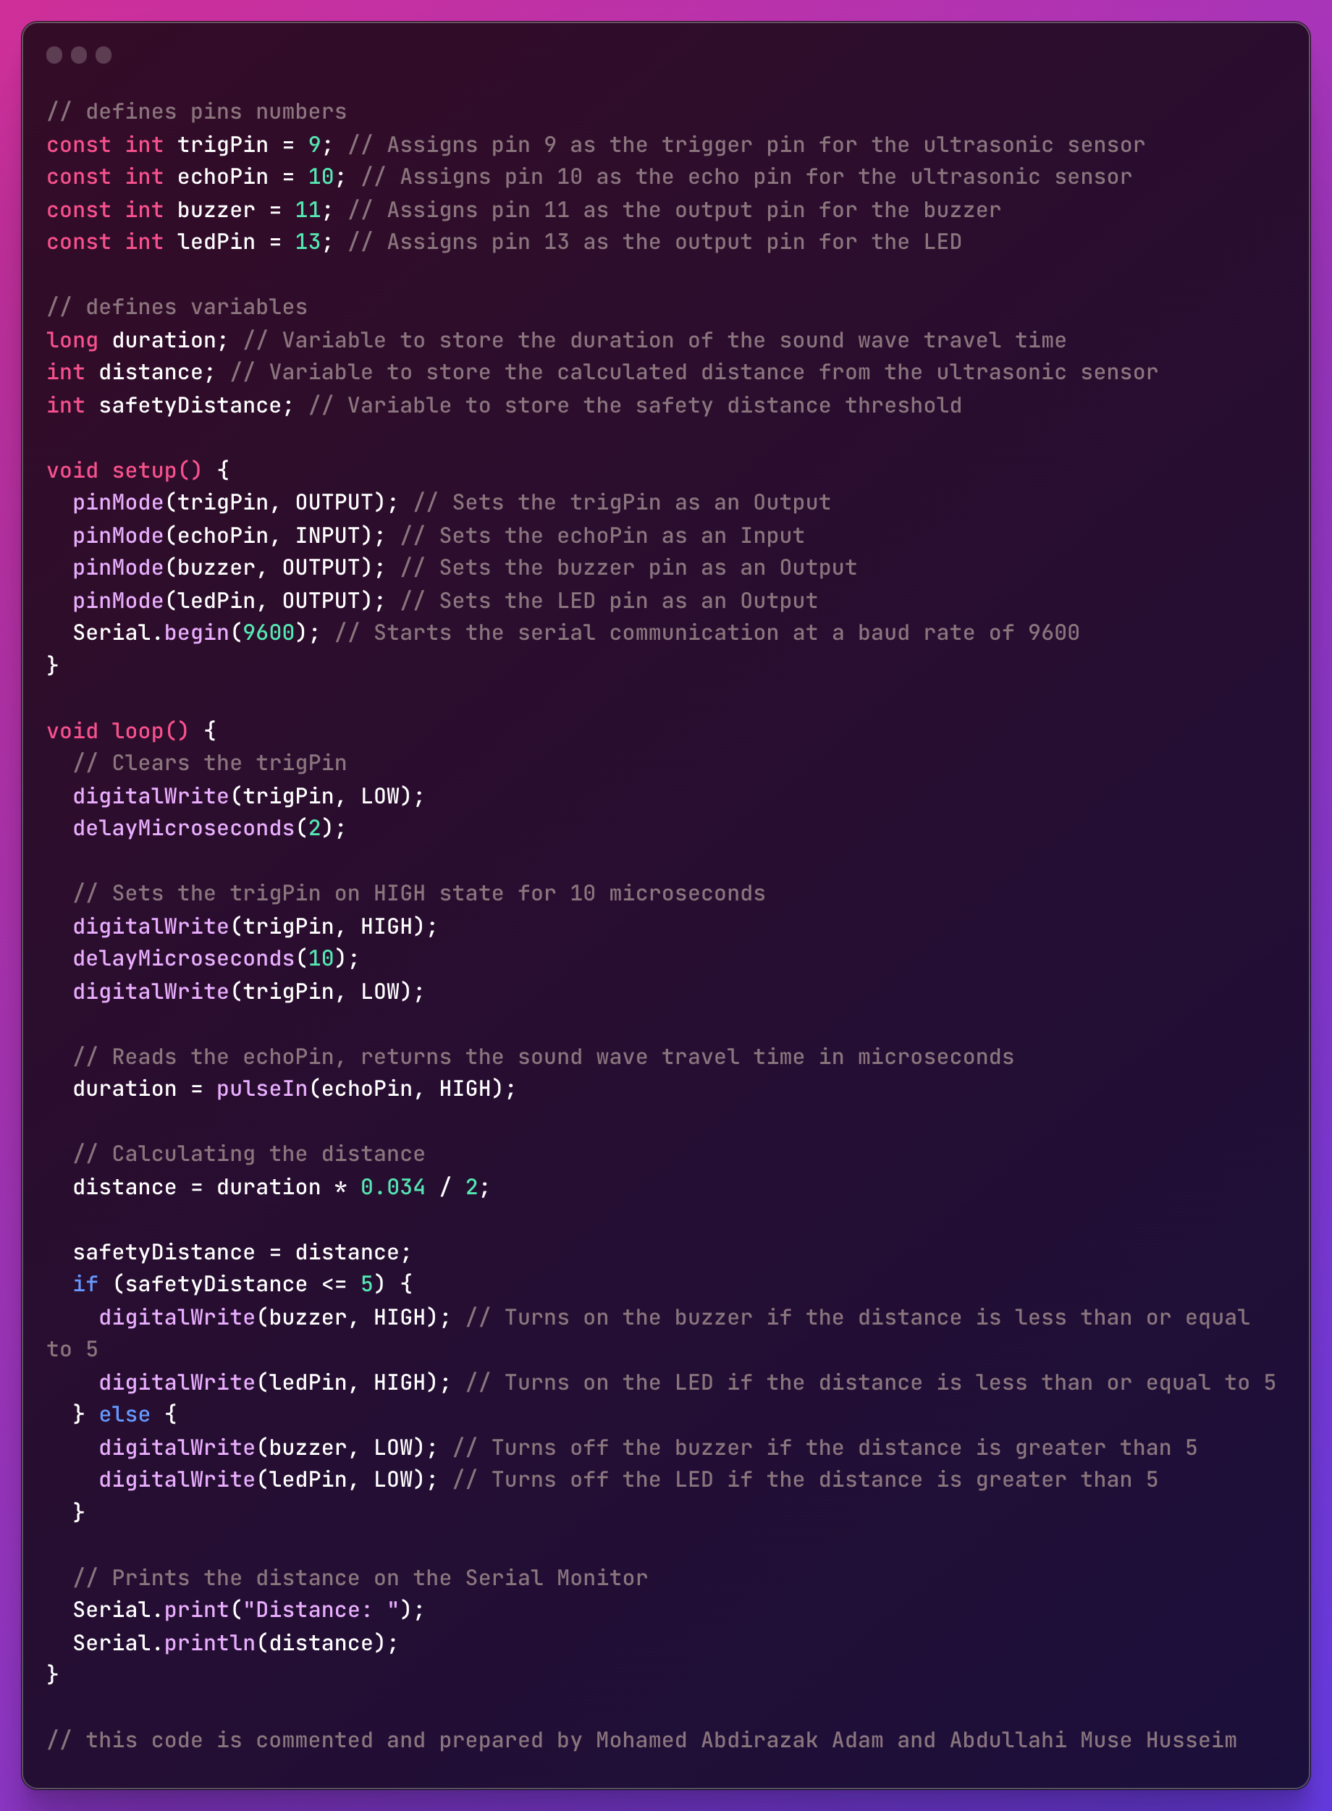

Slide 12
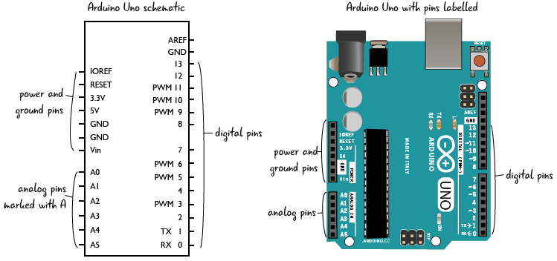
Diagram Design

Slide 13
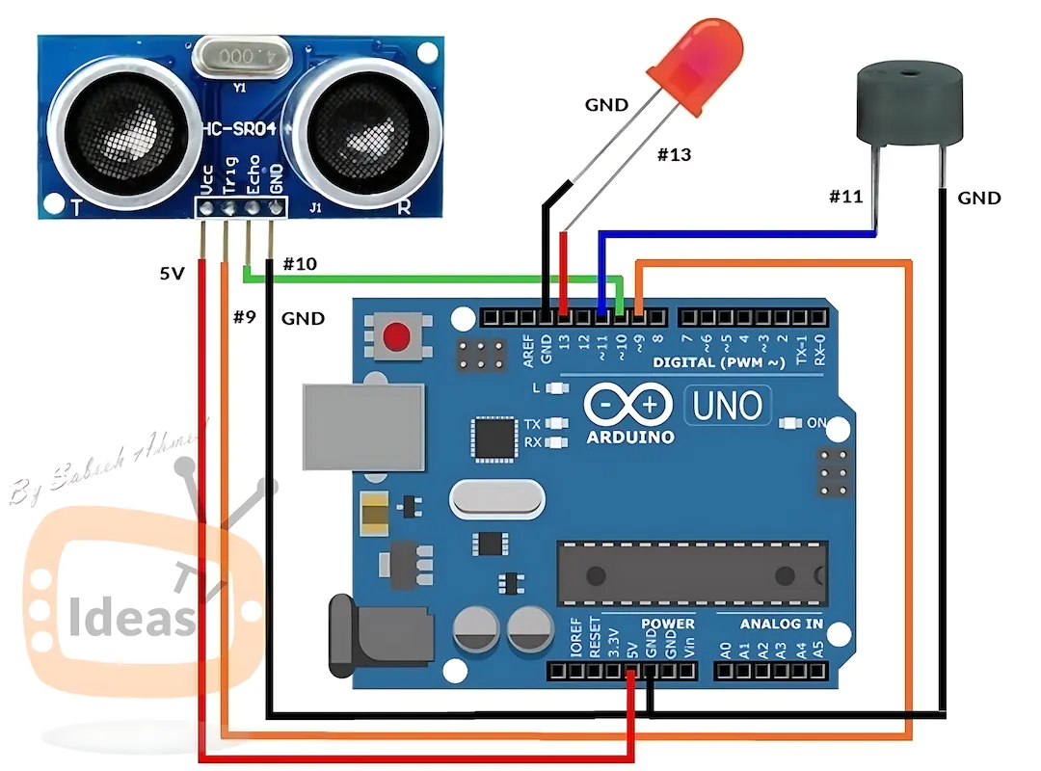

Slide 14
03
Result

Slide 15
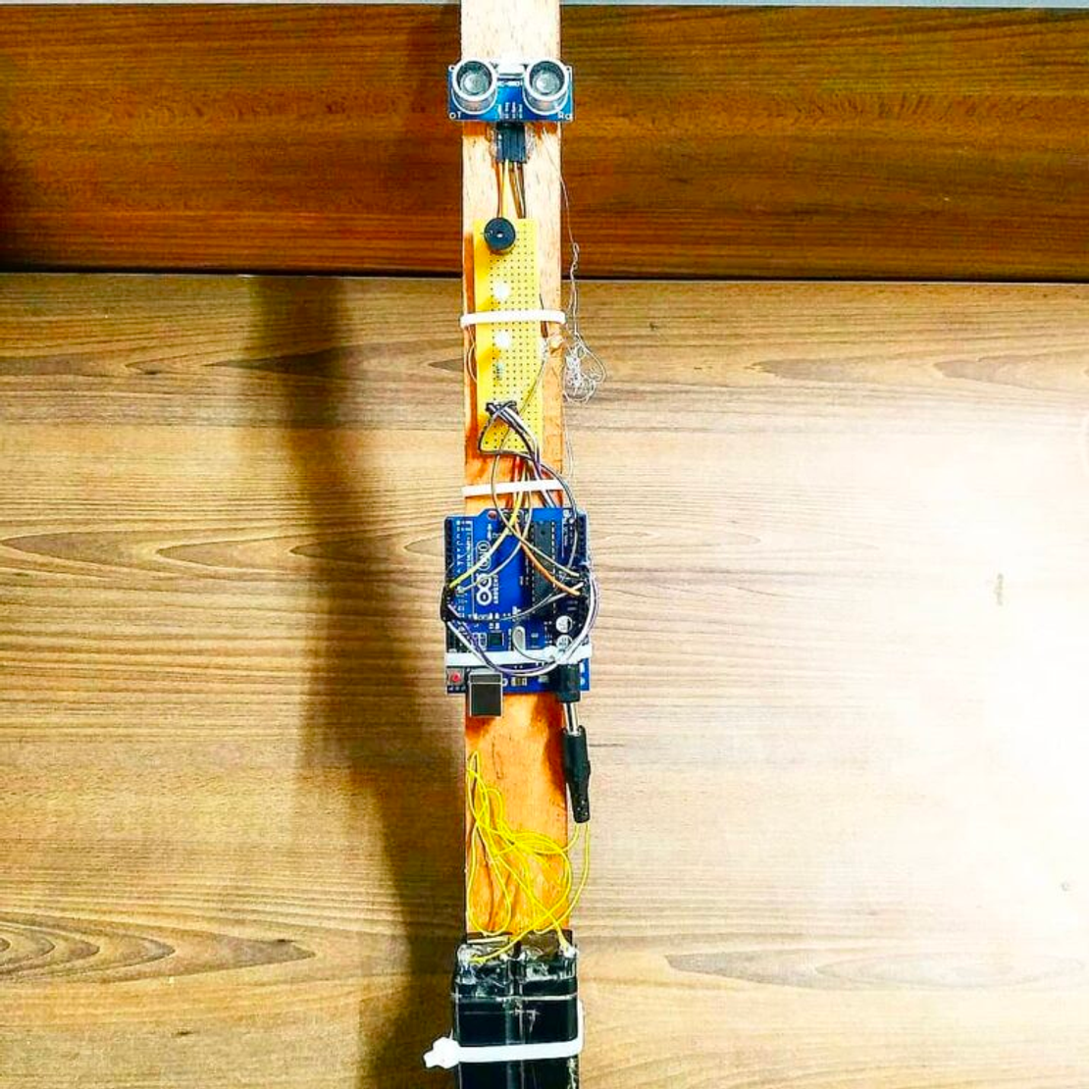
Final Result
1. Enhanced safety through real-time obstacle detection and alerts.
2. Improved mobility and independence for visually impaired individuals.
3. Accurate and reliable obstacle detection using the ultrasonic sensor.
4. User-friendly interface with intuitive audio and visual feedback.
5. Cost-effective solution utilizing affordable components.
6. Showcasing the capabilities of Arduino for innovative assistive technologies.
7. Encouragement for further innovation and development in this field.

Slide 16
04
Conclusion

Slide 17

Conclusion
The Smart Blind Stick project utilizing Arduino and an ultrasonic sensor offers an innovative solution for visually impaired individuals. By providing real-time alerts and enhancing mobility, it significantly reduces the risk of accidents and promotes independence. This technology showcases the potential of Arduino in creating impactful solutions for the betterment of society.

Slide 18


Slide 19

THANK YOU

